Slide 1
Coordinator Course
Disclosure Forms and Conflict of Interest

Slide 2
This session will cover:
What does Conflict of Interest (COI) mean?
What is commercial interest?
Why is this important to ACCME?
Who needs to complete a Disclosure Form?
What information must they disclose?
My speaker has a COI, what do I do now?
What happens if the disclosure is not received prior to activity?

Slide 3
What does Conflict of Interest (COI) mean?
A financial relationship to create conflicts of interest in CME when individuals have both a financial relationship with a commercial interest and the opportunity to affect the content of CME about the products or services of that commercial interest.

Slide 4
What is ineligible company
ACCME defines a commercial interest as any entity producing, marketing, re-selling, or distributing healthcare goods or services consumed by, or used on, patients.

Slide 5
Why is this important to ACCME?
“There is a risk that physicians will allow favorable drug messages learned in an educational context to change their clinical practices to favor use of those drugs, without critically appraising the evidence or fully assessing information from other sources.”
2007 Senate Finance Committee

Slide 6
Why do we collect this information?
The ACCME is committed to ensuring that accredited continuing education:
presents learners with only accurate, balanced, scientifically justified recommendations
protects learners from promotion, marketing, and commercial bias.

Slide 7
Who needs to complete a Disclosure Form?
Anyone who is in control of the content of an ACCME accredited activity.
Planners
Committee Members
Speakers
Moderators
Discussants
Facilitators
Poster Presenters
CME Reviewers

Slide 8
What information must they disclose?
The name of the ineligible company with which the person has a financial relationship.
The role of the financial relationship:
Researcher
Consultant or Advisor
Speaker
Independent Contractor
Royalties or Patent Beneficiary
Executive Role
Individual Stocks & Stock Options
Based on the activity, these two roles will most likely need to be recused (dismissed):
Employee
Ownership Interest

Slide 9
My speaker has a possible COI, what now?
Both CPL Staff and the Coordinator are automatically notified when a speaker indicates on their Disclosure Form:
In the past 24 months, I have had financial relationships with ineligible companies.

Slide 10
Next Steps, 14-Days prior to the activity
Planning Faculty contacts the speaker and discusses with him/her:
There will/will not be any mention of these companies and/or their products in the slides/presentation.
The content of the education will/will not be related to the products of the company(s) listed.
Planning Faculty emails CPL Staff, the findings of this conversation, listing each company separately.

Slide 11
Next Steps, 7-Days prior to the activity
Presentation is uploaded to Smartsheet and the urgent check box is selected.
Both the CPL Staff and the Planning Faculty must review the presentation slides, abstracts and handouts, and they cannot contain:
Advertising
Corporate logo or trade name
Product group message
The use of generic names or adding multiple names of products are required.
Planning Faculty emails CPL Staff the findings of their review, and if no changes, this email is added to the file for documentation of the process. If changes are need, speaker is contacted and documents are again reviewed.

Slide 12
Next Steps, Day of the activity
Planning Faculty completes an evaluation of the presentation, using CPL's Education Planning Faculty Evaluation Form.
Document is uploaded into Smartsheet to complete this task.

Slide 13
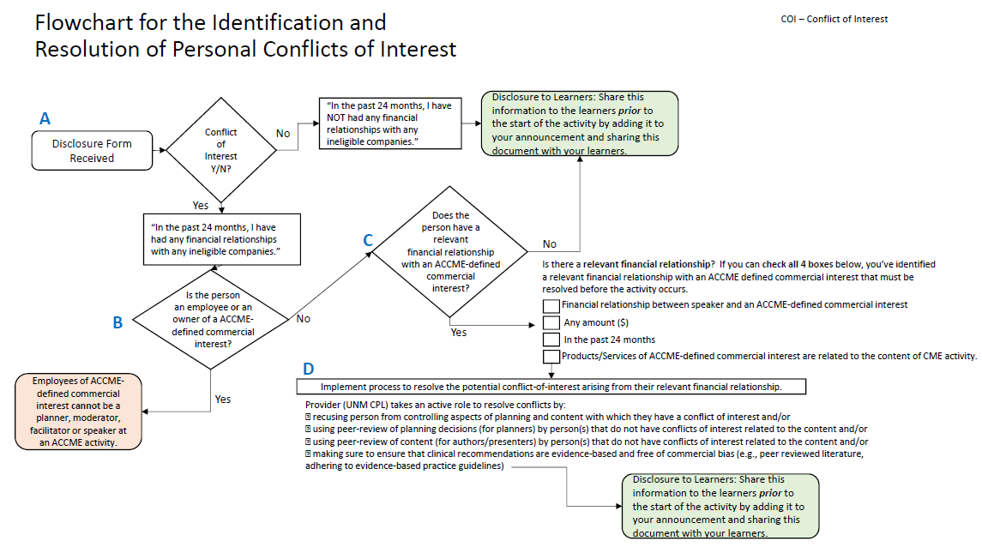
Flowchart for Resolving COI’s

Slide 14
What happens if the disclosure is not received prior to activity?
The speaker must be recused or no credit will be awarded for that activity.

Slide 15
UNM CPL’s Two Week Policy
The announcement and speaker disclosures must be received two weeks prior to the activity.
This allows us to determine if there is a COI and have time to resolve it.

Slide 16
Disclosure Statement on Announcement if no COI
ACCME requires us to add the Disclosure Statement to the announcement. You will use this verbiage if the speaker has no conflict of interest.
DISCLOSURE STATEMENT:
UNM CPL policy, in compliance with the ACCME Standards of Commercial Support, requires that anyone who is in a position to control the content of an activity disclose all relevant financial relationships they have had within the last 24 months with any commercial interest.
The following planners and faculty listed have disclosed that they do not have relevant financial relationship with a commercial interest:
Your Faculty Planner’s Name and Degree (must be listed on all announcements)
Your Speakers Name and Degree

Slide 17
Disclosure Statement on Announcement if speaker has a COI
You will use this verbiage if the speaker has a conflict of interest.
The planners and faculty listed below have disclosed that they have a relevant financial relationship with a commercial interest. The relationships were reviewed by UNM CPL and the planning committee, and conflicts of interest were resolved prior to the activity.
Name: Speaker’s Name and Degree
Commercial Interest: Name of Commercial Interest Company
Relationship: (List whatever is checked on their form)

Slide 18
CME Reviewers
ACCME requires anyone who is in control of the content of an ACCME accredited activity to provide their financial disclosure information. This includes CPL Staff who review applications and make recommendations to these programs. Therefore, this statement must be included on your announcement.
The following CME Reviewers disclose that they have no relevant financial relationships with any commercial interest: Kathy Breckenridge, Robert P. Giebitz, PhD, Jennifer Harbaugh and Gary Smith, PhD.

Slide 19
A Typical Disclosure Statement on Announcement
DISCLOSURE STATEMENT:
UNM CPL policy, in compliance with the ACCME Standards of Commercial Support, requires that anyone who is in a position to control the content of an activity disclose all relevant financial relationships they have had within the last 24 months with any commercial interest.
The following planners and faculty listed have disclosed that they do not have relevant financial relationship with a commercial interest:
Your Faculty Planner’s Name and Degree (must be listed on all announcements)
Your Speakers Name and Degree
The following CME Reviewers disclose that they have no relevant financial relationships with any commercial interest: Kathy Breckenridge, Robert P. Giebitz, PhD, Jennifer Harbaugh and Gary Smith, PhD.
Remove the paragraph below if none of your speaker’s indicate they have a conflict:
The planners and faculty listed below have disclosed that they have a relevant financial relationship with a commercial interest. The relationships were reviewed by UNM CPL and the planning committee, and conflicts of interest were resolved prior to the activity.
Name: Your speaker’s Name and Degree
Commercial Interest: Name of Commercial Interest Company
Relationship: (List whatever is checked on their form)

Slide 20
The End
There was a lot of information covered in this set of slides. If you have questions about any of what was covered, please feel free to contact our office. We are here to help and guide you through the process.

